Slide 1
Scanners
Notes:
https://www.programiz.com/java-programming/scanner (contains basic info)

Slide 2
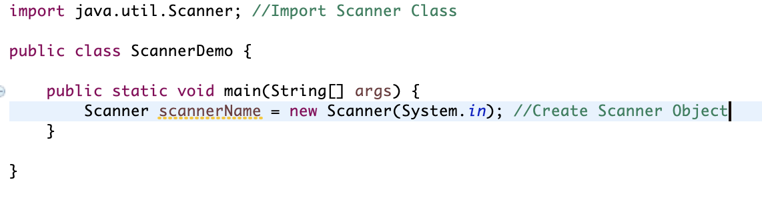
Scanners
Scanner class is used to get user inputs and can be found in java.util package. In order to use scanners we must first create an object of this class and import it.

Slide 3
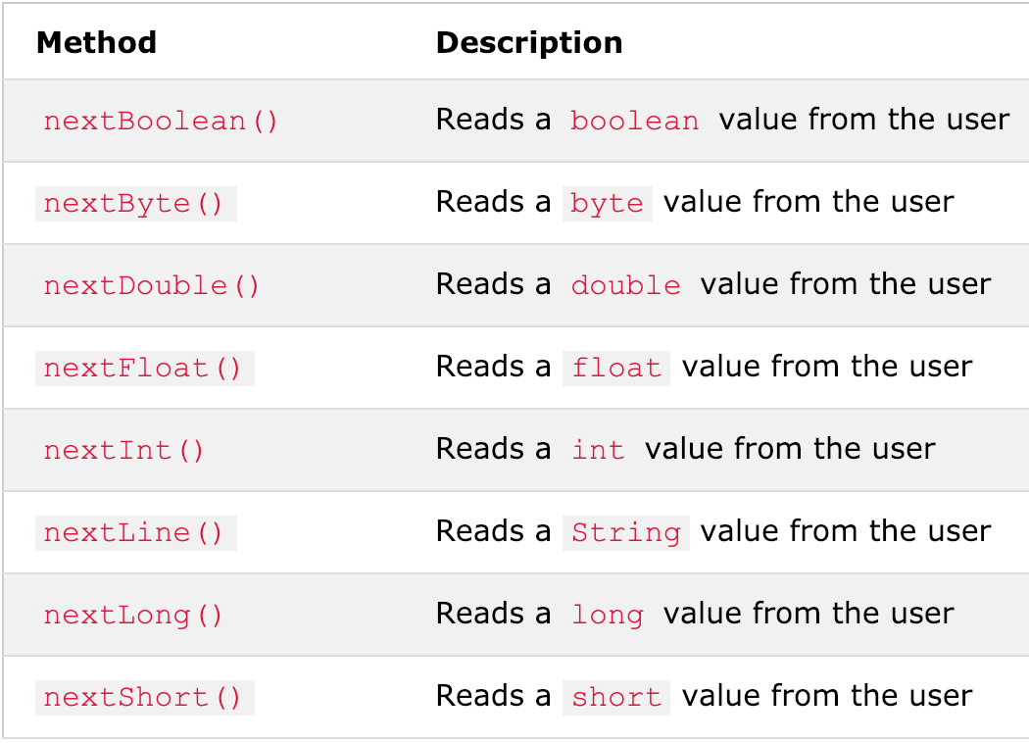
Scanner Methods
Using the Scanner object we can access a lot of different methods from the scanner class.
Also if user inputs the wrong type you will get an exception/error message like "InputMismatchException"
there is also a .next() method that finds and returns the next complete token from this scanner.

Slide 4
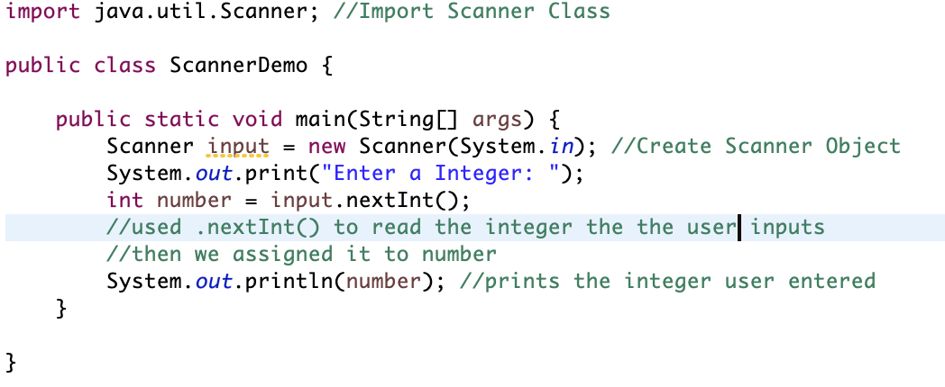
Scanner Usage (Exercise)
We can use these methods to read the user input and assign them to variables.

Slide 5

Example of output of previous code

Slide 6
Practice Problem#1 (if statements)
Using Scanner and if statements, write a code that reads an integer from the user and tell them if it is larger than 10 or not. If the number is 10 then print "is ten". However if the integer is larger than 10 print "(input) larger than ten" else print "(input) less than ten"

Slide 7
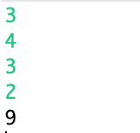
Practice Problem#2 (loops)
Using loops make a code that first takes in an integer n. Then make a code that will ask the user for any integer n times. Add up all of these values and print the sum.
Output should look something like:
3 is n
4,3,2 are the user inputs
9 is the sum of the user inputs (4+3+2=9)

Slide 8
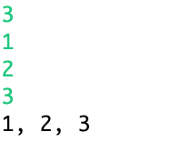
Practice Problem#3 (array)
Write this code using an array type int. This code should first receive a user input that determines the length of the array. Then make a loop that receives inputs array length number of times. These inputs should be assigned into the array. Then print the array separated by a ", ". The end of the print statement should not be ", ".
Ex output:
3 is array length
1,2,3 are user inputs
1, 2, 3 is printed (there is no ", " after 3)

Slide 9

Practice Problem#4 (methods)
Write a code that gets an integer input from the user and prints true if it is a odd number and false it it is not. You must make and use a method that takes in an integer and returns true or false depending on if the input is odd or even.
Ex output:
3 is odd so the code will return true

Slide 10
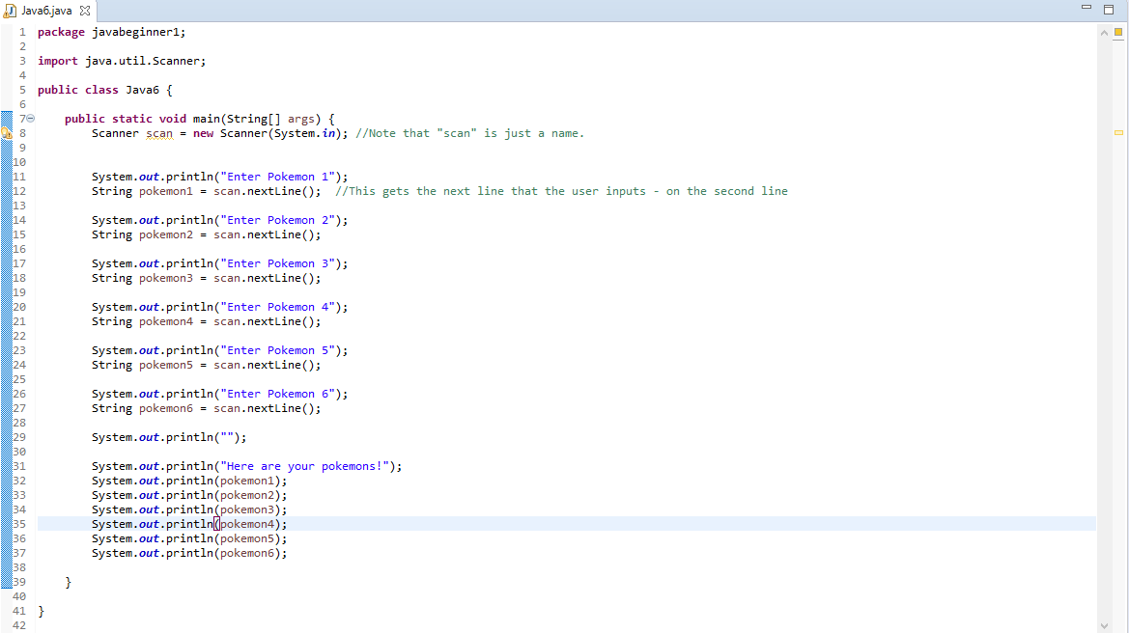
*Skip if everyone understands (easy/fun example)
This is the basic concept of scanners

Slide 11

Practice Problem#5 (arraylist)
HW: Problem 1
Have a number n inputted from user (1~4)
Then take in two numbers, a and b from the user
If n is 1 add a and b; if n is 2 subtract a and b; if n is 3 divide a and b; if n is 4 multiply a and b
Write a code that will endlessly ask the user for an integer add it to the arraylist until they input 0. Add up all of the odd indexes in the arraylist and print it.
Ex output:

Slide 12
Practice Problem#5 (arraylist)
HW: Problem 2
Then take in two numbers, a and b from the user
Print out GCF and LCM of A and B (greatest common factor and least common multiple)
Print GCF(a,b) * LCM(a,b) ⇒ recognize something??
Write a code that will endlessly ask the user for an integer add it to the arraylist until they input 0. Add up all of the odd indexes in the arraylist and print it.
Ex output:

Slide 13
End of Presentation

